Slide 1
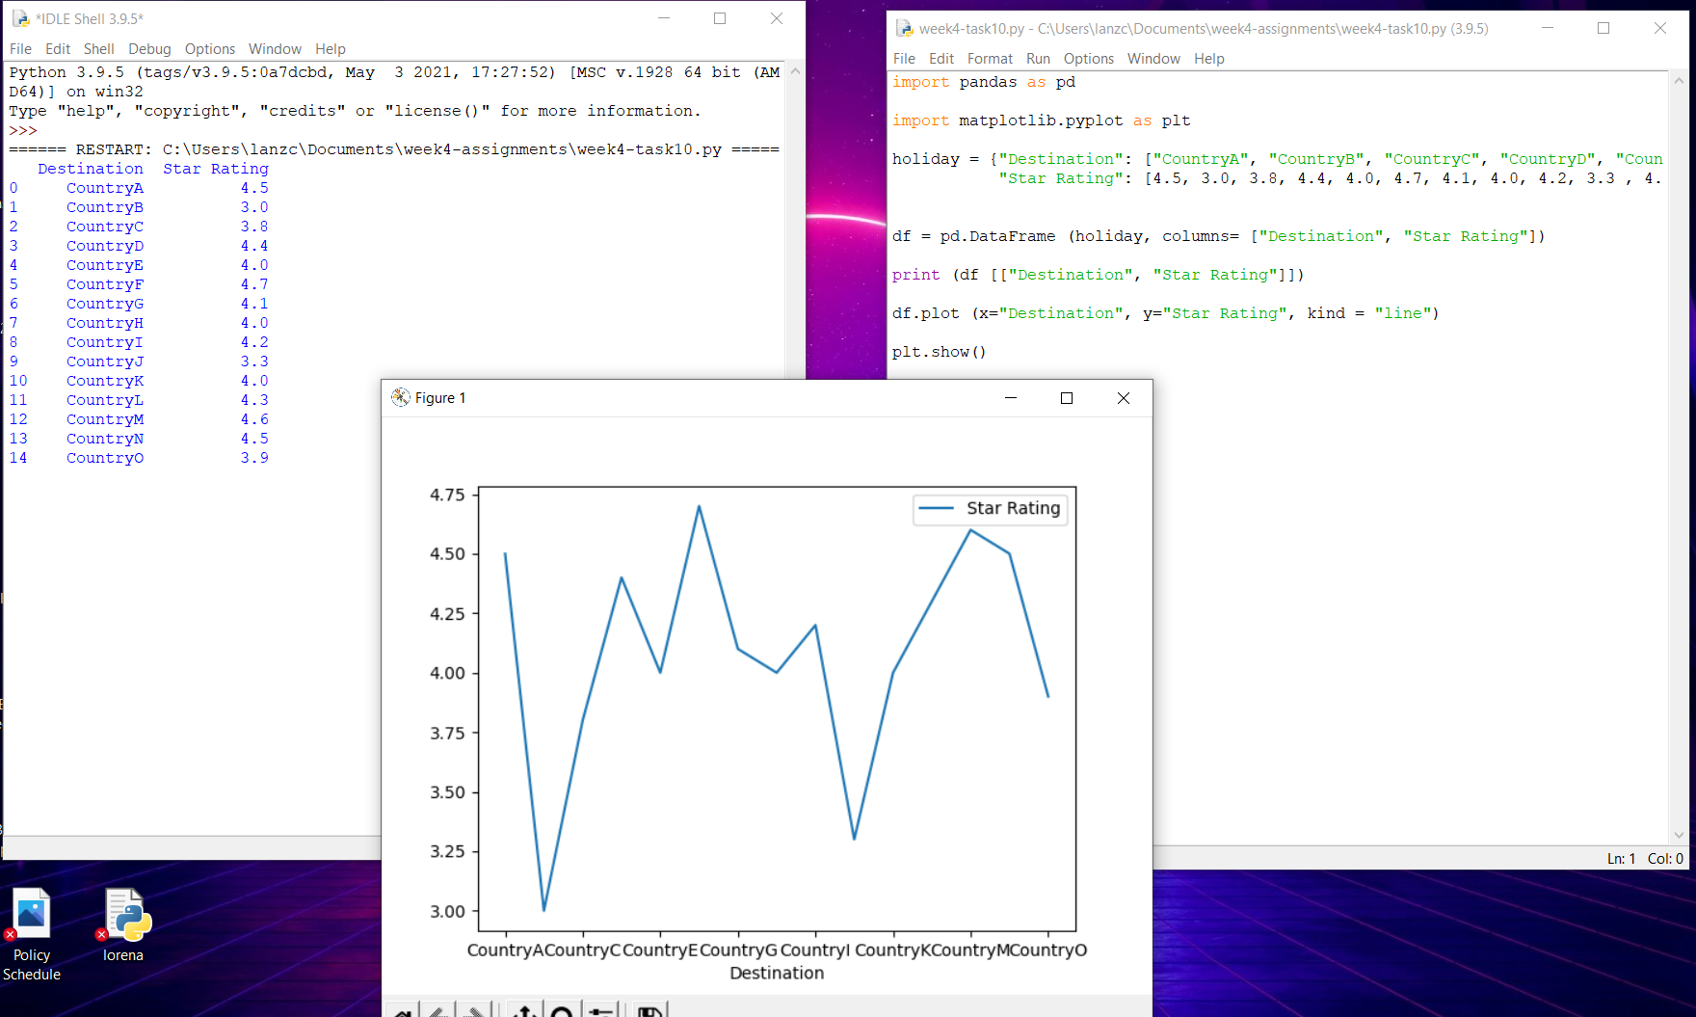
Practical 10
I used pandas to create a data frame for Holiday (Destinations) and the rating (Star Rating)
Using plot, I created the x and y axis for my graph and included the type of graph that I will use
To print the graph I used the command plt.show

